Slide 1
Downsview Soccer League
Training Manual
2023

Slide 2
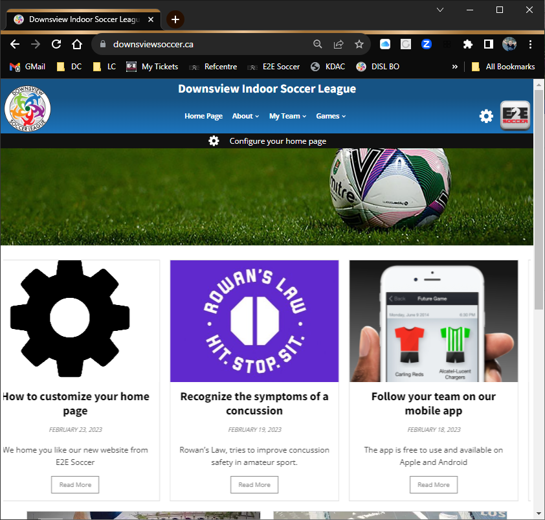
Your new website
The DISL website is now at
www.downsviewsoccer.ca

Slide 3
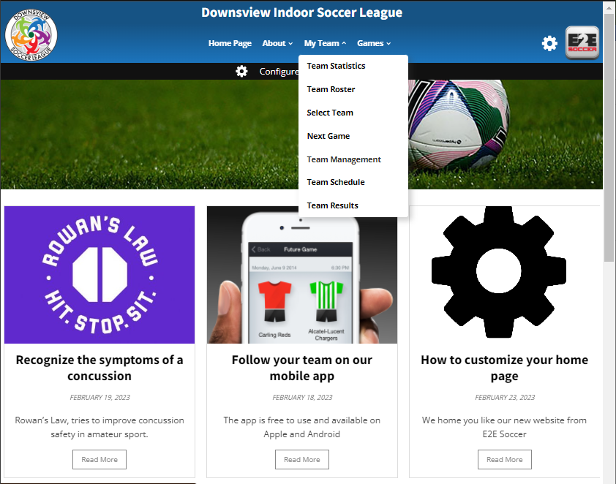
How to Activate
Each team manager and coach is
required to set up an account with
the site.
To do this go to the My Team and select Team Management

Slide 4
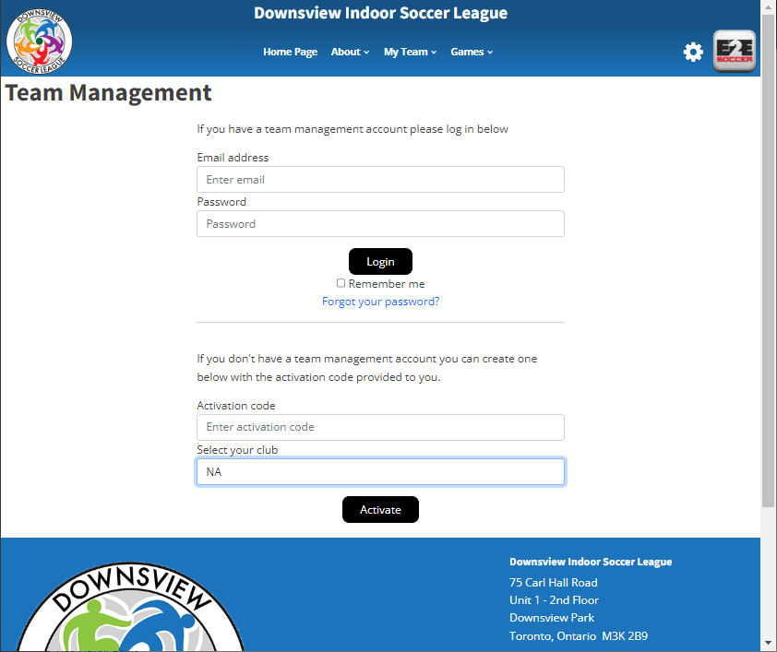
How to Activate
To activate your account go here
and enter this activation code.
Please contact your club
Choose your club name from the drop down menu
Then click the Activate button

Slide 5
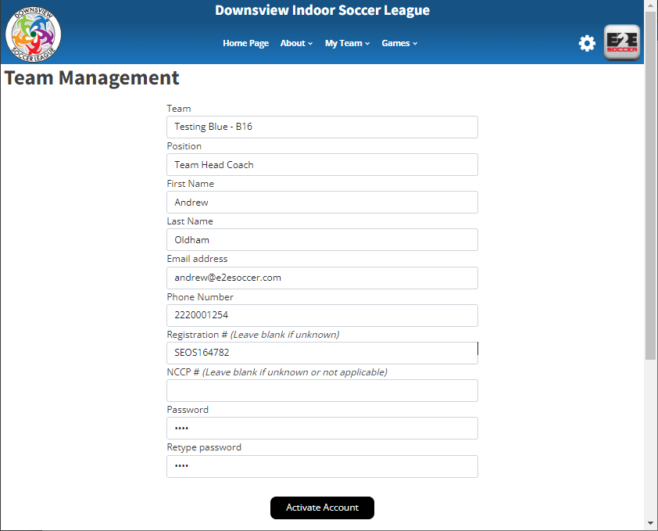
How to Activate
Make sure that you select the correct
team here
Fill in the rest of the page and click the
Activate Account button

Slide 6
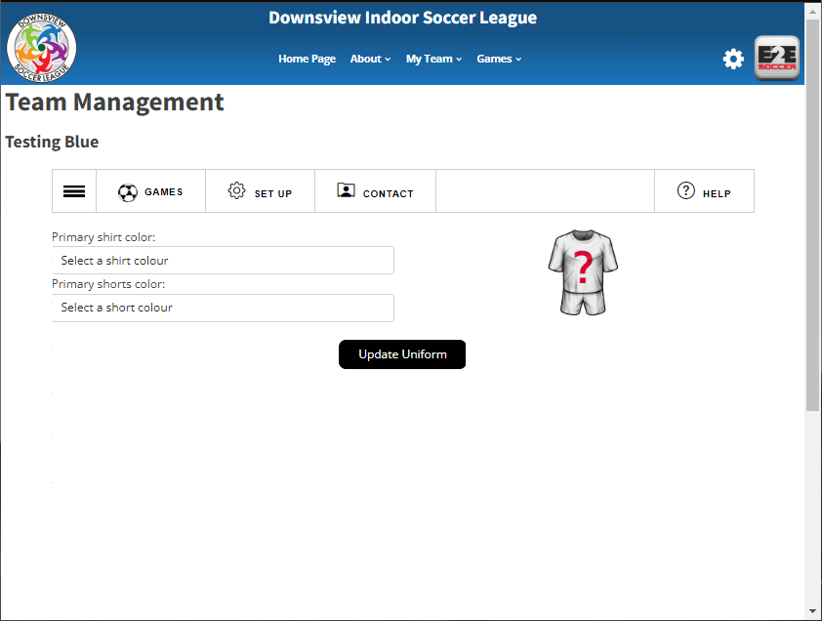
Your Options
You will now be taken to the Team
Management module
There are 4 tabs in this module
Games
Set Up
Contact
Help
Click on the 3 lines to open the submenus for each tab.

Slide 7
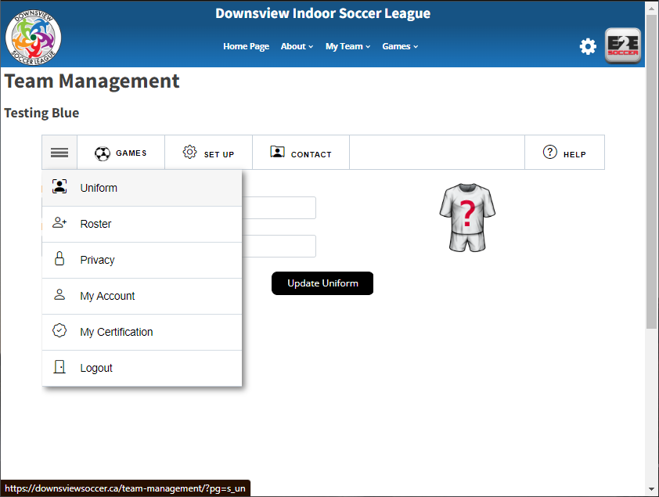
Setting up your team
In each tab is a series of tools
Click on the button to visit that tool

Slide 8
Setting your Uniform Colour
Start in the Set Up menu
First enter your uniform by selecting
your shirt and shorts in the drop downs
Click the Update Uniform button to save

Slide 9
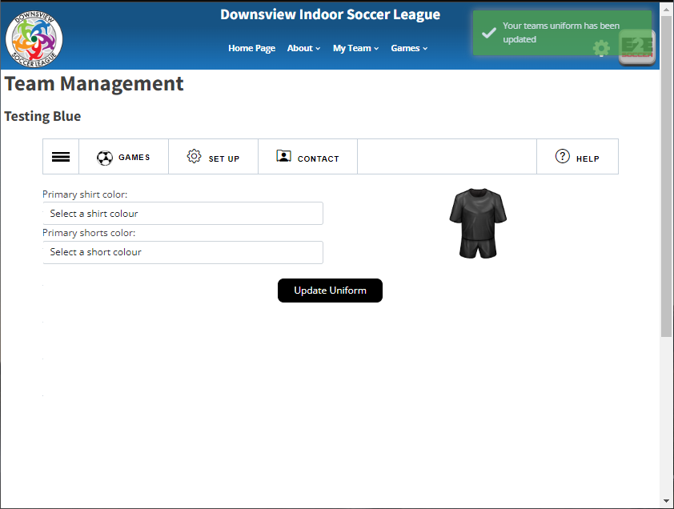
Setting your Uniform Colour
A green message will tell you that the action was successful
It will be red if there is a problem

Slide 10
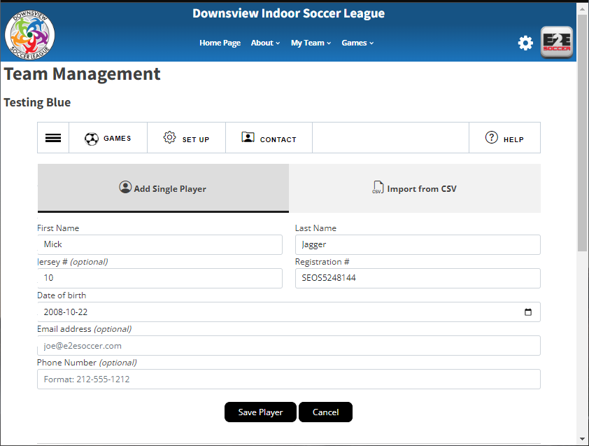
Adding Your Roster
Now stay in the set up menu and select
the Roster tool
Now enter your players
You can add them one at a time
or
You can import a csv file of your roster

Slide 11
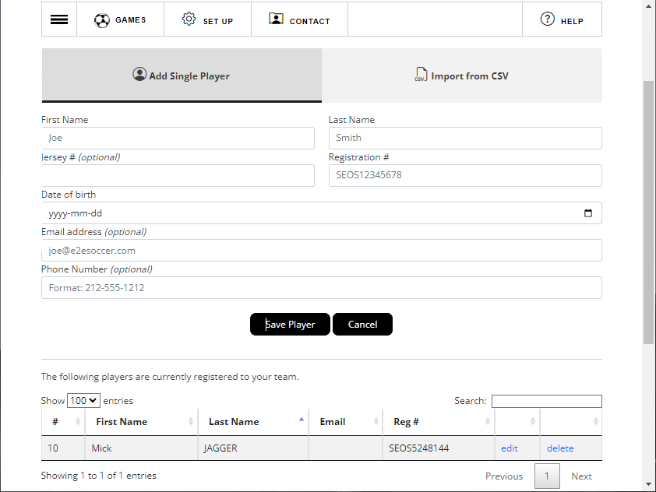
Adding Your Roster
After the player has been added
he or she will be listed in the table
below the buttons
If you need to edit or delete the
player use these links

Slide 12
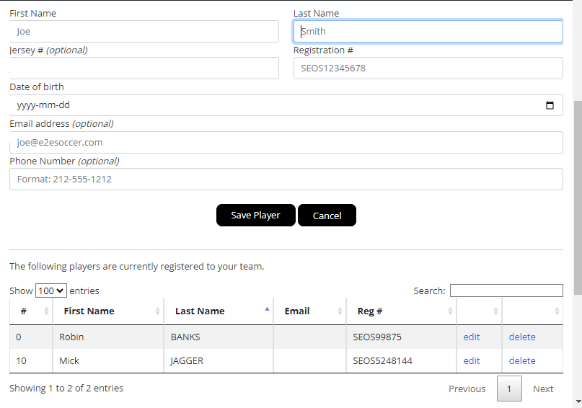
Setting Jersey Numbers
To update a jersey number after having added a player, you can click edit.

Slide 13
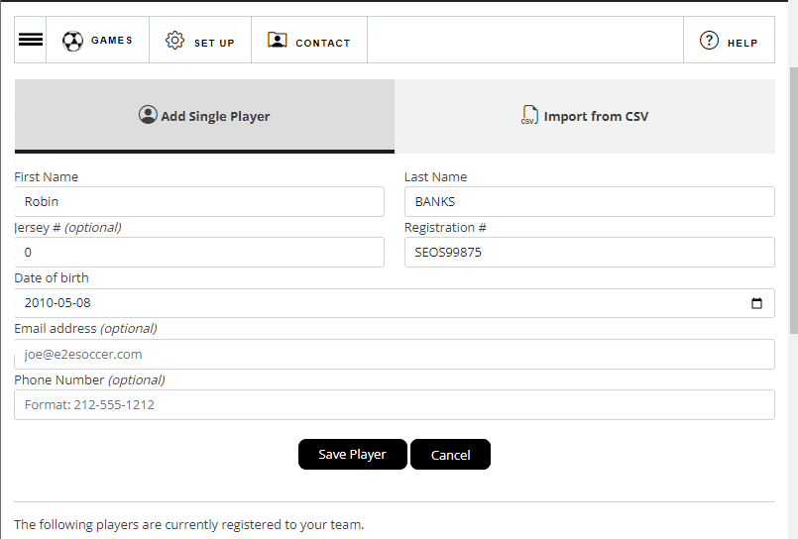
Setting Jersey Numbers
The players jersey number can be added here:
Click Save Player to allow the players number to appear on the game sheet.

Slide 14
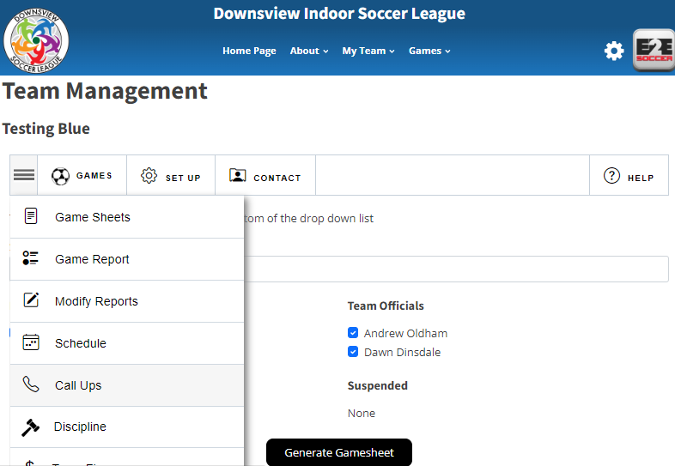
Adding Call Ups
Call Ups can be added to your game sheet by selecting them through the Call Ups Tab, under Games heading.

Slide 15
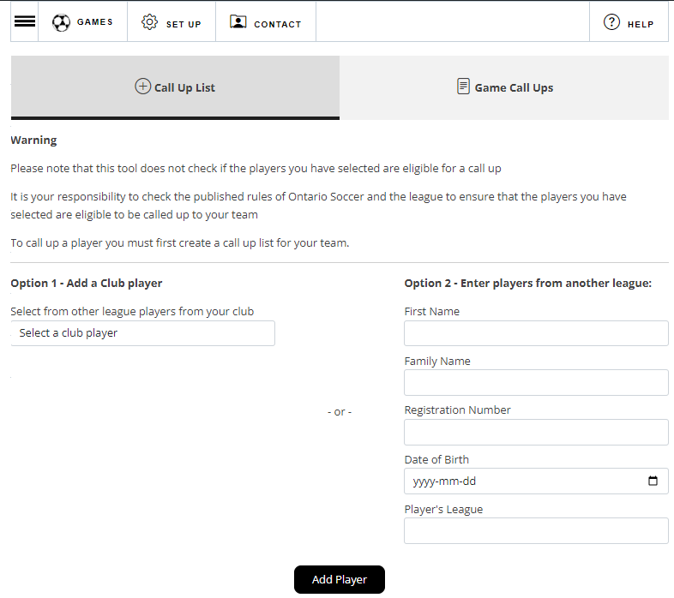
Adding Call Ups
A player can be selected from a team already in the league.
Or you can enter a player from another league – please remember they need to be registered with Ontario Soccer and a roster must be provided for the player.
Click Add Player

Slide 16
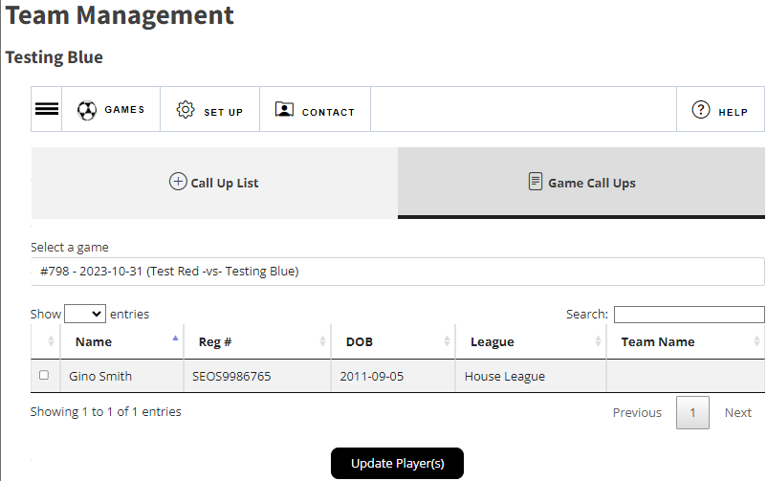
Requesting a Call Up for your Game
Now switch to the Game Call Ups tab
Choose the game from the drop down menu.
Click the box beside the players name and click update player(s).

Slide 17
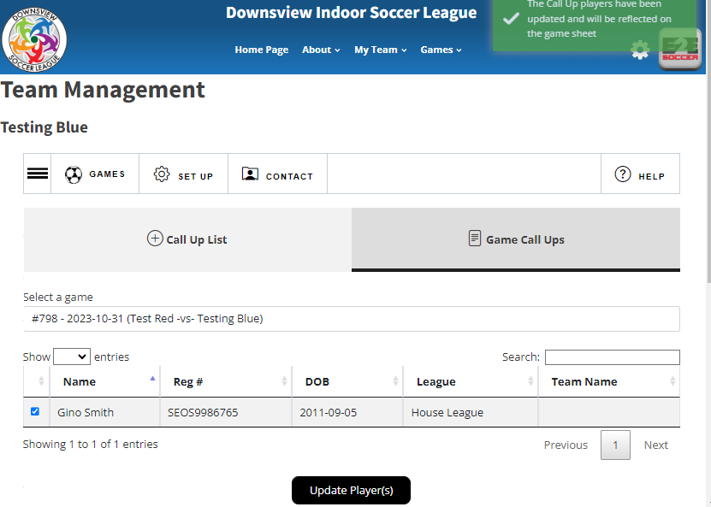
Requesting a Call Up for your Game
The green box will appear when the player has been added to your game.

Slide 18
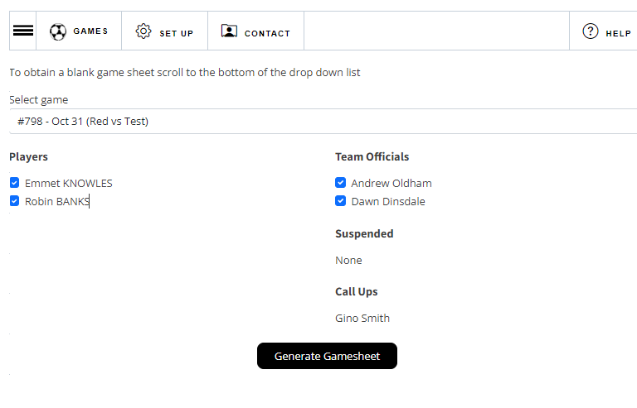
Generating a Game Sheet
After you have entered your roster, you can create a gamesheet
To do this go to the Games tab.
Click the 3 lines icon to see the options under Games, click gamesheets.
Choose your players who will be attending the game and click Generate Gamesheet
A gamesheet will appear in a new window.
Print it out and bring it to the game

Slide 19
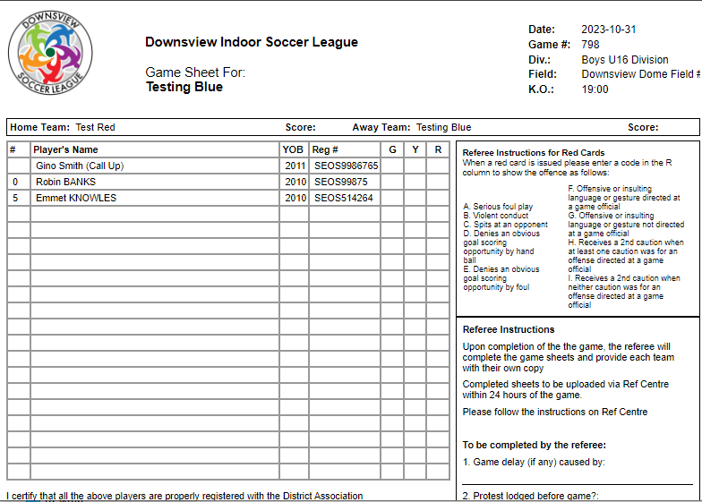
Sample Game Sheet
This is your game sheet
Make sure all staff members who are on the bench sign it before you hand it to the referee

Slide 20
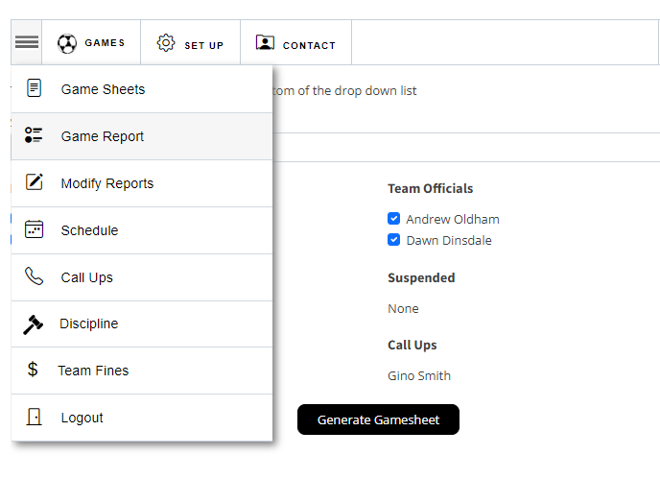
Entering your Game Report
After your game you are required to submit a game report.
Under the Games heading, select Game Report.
Both teams have to submit a report
If you are the first team to submit then you will be asked for the score
If you are the second team to submit you will be asked to agree with the score entered by your opponents

Slide 21
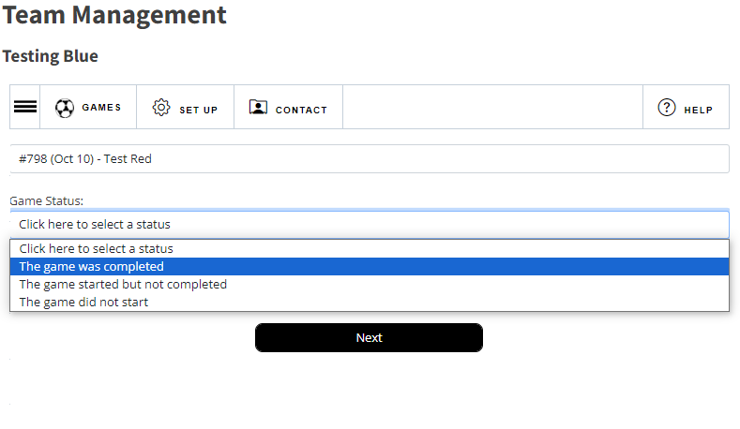
Game Reports
Your game will appear in the drop down list.
Select the Game Status
Click Next

Slide 22
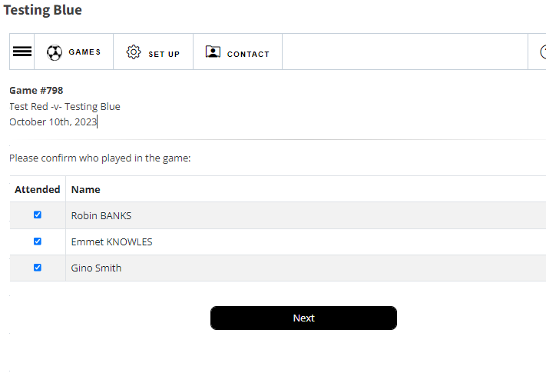
Game Report
Select the players who attended the game.
Click Next

Slide 23
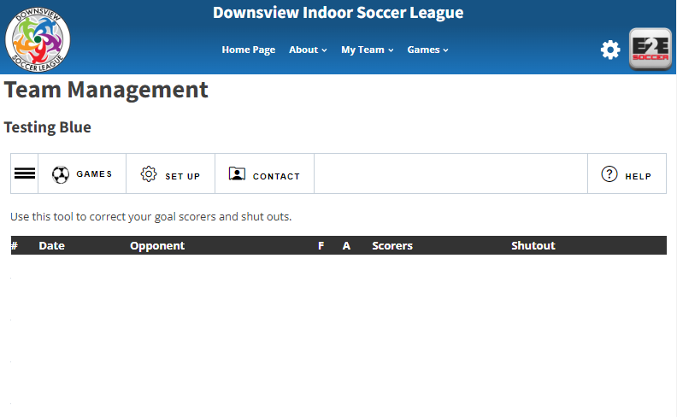
Team Contacts
To view your teams contact information or your opponents contact information, go to Contact

Slide 24
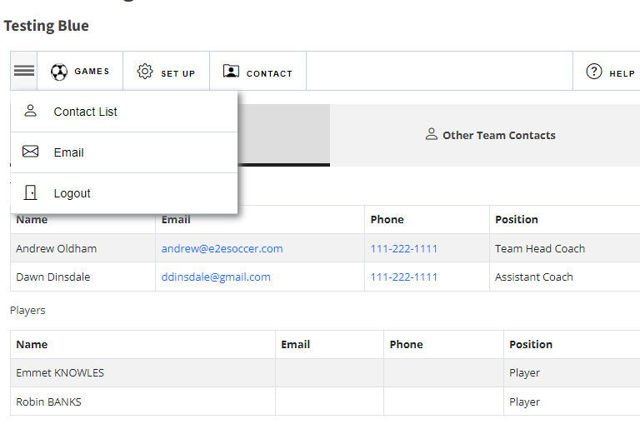
Your Team Contacts
Your team officials contact information is listed and any player contacts entered will be available to your team only.
You are able to email your team through the website using the email function.

Slide 25
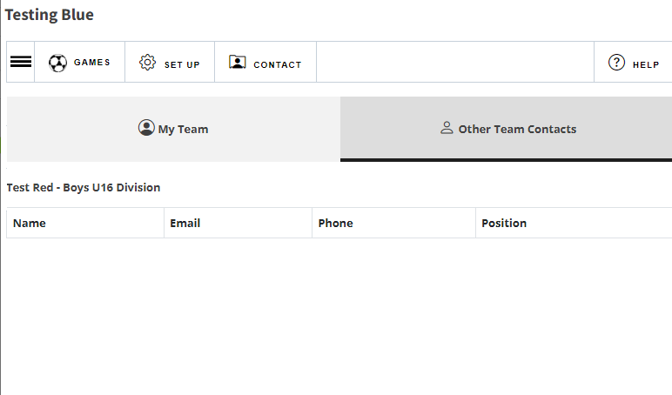
Opponents Team Contacts
To view your opponents contact information click on the Other Team Contacts tab.
All teams in your division are listed.
Only team officials who are logged in will have access to this page.

